Slide 1
PROCESS SCHEDULER
Presented By:
Mahnoor Aftikhar (22-CS-153)
Minahil Hijab (22-CS-194)

Slide 2
TABLE OF CONTENTS
Introduction
Objective
Methodology
Sample Output
Results & Analysis
Conclusion

Slide 3


INTRODUCTION
MOTIVATION
To implement the following CPU scheduling algorithms as an Operating Systems Lab Project:
First-Come, First-Served (FCFS)
Shortest Job Next (SJN)
Round Robin (RR)
PURPOSE
Evaluate waiting times.
Compare algorithm performance.
Understand scheduling strategies.

Slide 4
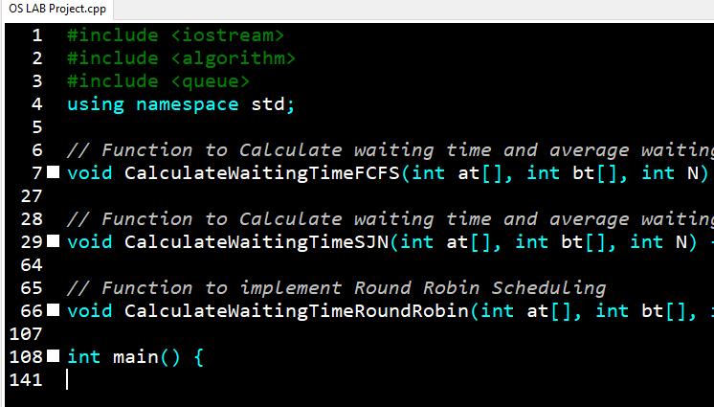

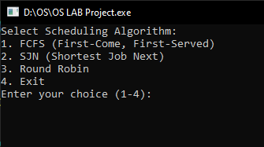

OBJECTIVES
Implement CPU scheduling algorithms using C++.
Demonstrate influence of Arrival Time (AT) and Burst Time (BT) on Waiting Times (WT).
Compare average Waiting Times for FCFS, SJN, and RR algorithms.
METHODOLOGY
Language: C++
Compiler: Dev C++ or gedit
Key Functions:
CalculateWaitingTimeFCFS
CalculateWaitingTimeSJN
CalculateWaitingTimeRoundRobin
User Interaction: Menu-driven interface.

Slide 5
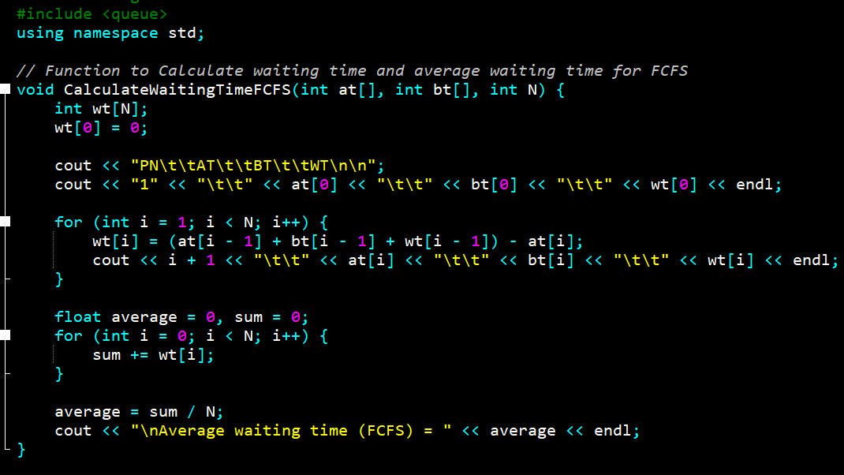
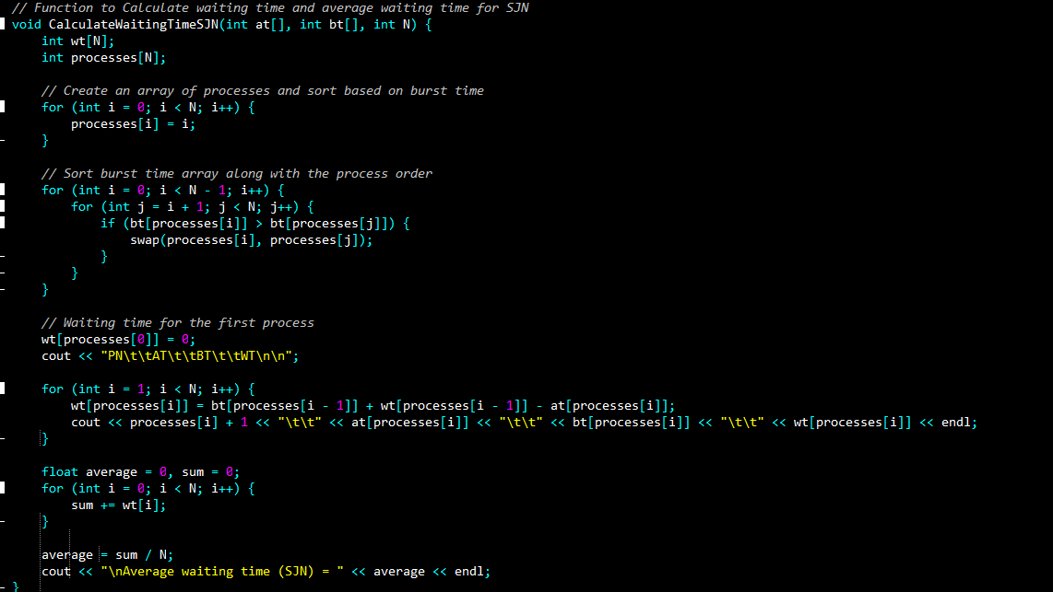
METHODOLOGY
(CONT.)
FCFS FUNCTION
Takes the queues AT, BT and Number of Processes as input parameters and creates WT queue.
Calculates the Waiting Time for each process:
wt[i] = (at[i - 1] + bt[i - 1] + wt[i - 1]) - at[i];
Displays AT, BT and WT of each process.
Calculates and Displays the average waiting time of all the processes
SJN FUNCTION
Takes the queues AT, BT and Number of Processes as input parameters and creates WT queue.
Sorts the processes based on their burst time using bubble sort.
Calculates the Waiting Time for each process:
wt[i] = (at[i - 1] + bt[i - 1] + wt[i - 1]) - at[i];
Displays AT, BT and WT of each process.
Calculates and Displays the average waiting time of all the processes

Slide 6
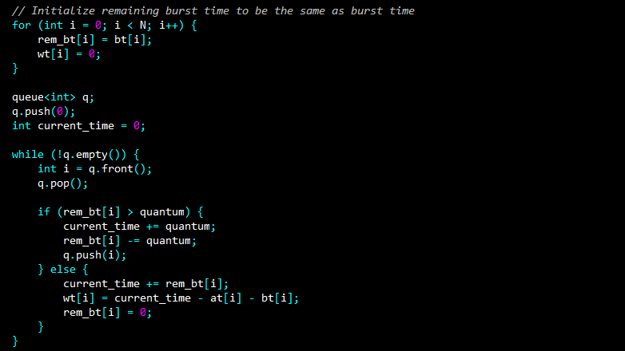
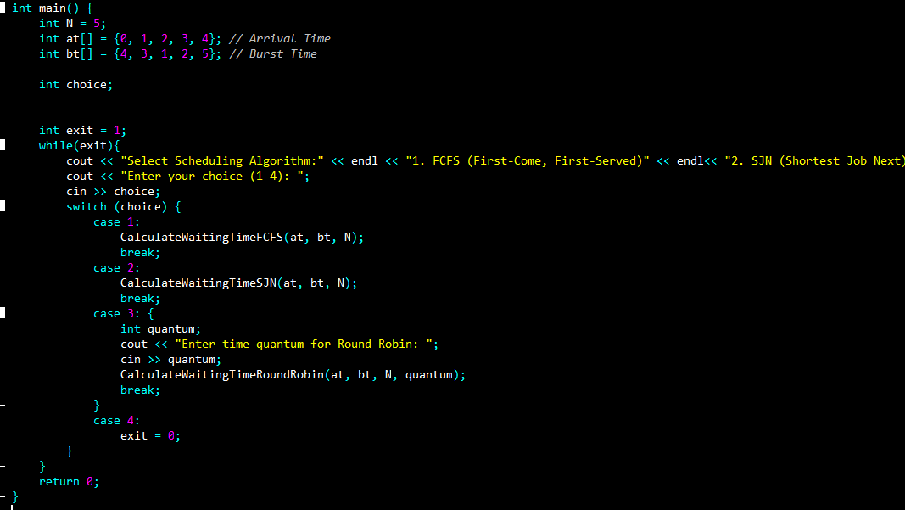
METHODOLOGY
(CONT.)
RR FUNCTION
Takes the queues AT, BT, Number of Processes and time quantum as input parameters and creates WT queue.
Schedules the processes for time quantum and stores remaining BT of each process in a separate queue for further scheduling.
Calculates the Waiting Time for each process:
wt[i] = (at[i - 1] + bt[i - 1] + wt[i - 1]) - at[i];
Displays AT, BT and WT of each process.
Calculates and Displays the average waiting time of all the processes
MAIN FUNCTION
Initializes STL queues AT, BT and Number of Processes.
Maintains the Menu through a switch statement.
Calls FCFS function if user enters 1.
Calls the SJN function if user enters 2.
Calls the RR function if user enters 3.
Exits the program if user enters 4.

Slide 7
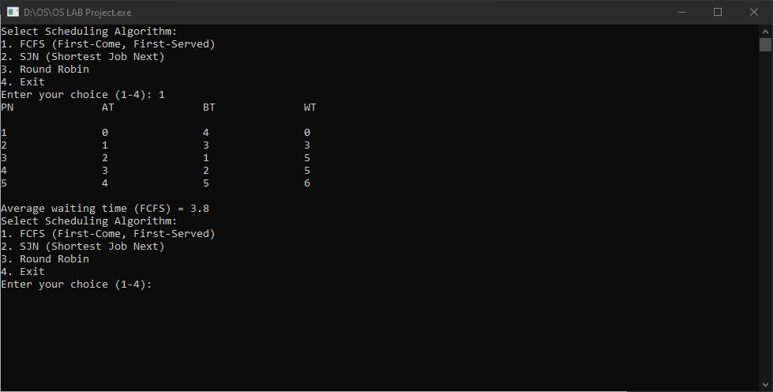
FCFS
OUPUT SAMPLE
AVERAGE TIME : 3.8

Slide 8
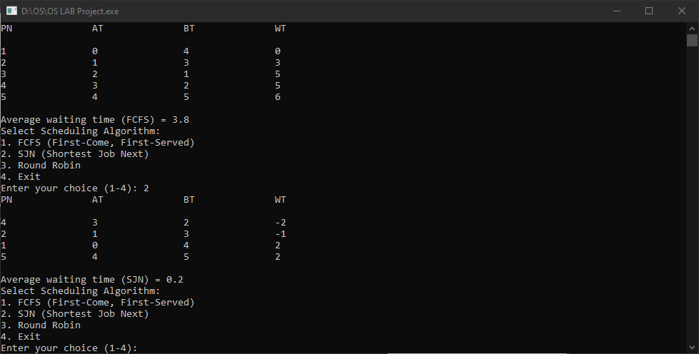
SJN
OUPUT SAMPLE
AVERAGE TIME : 0.2

Slide 9
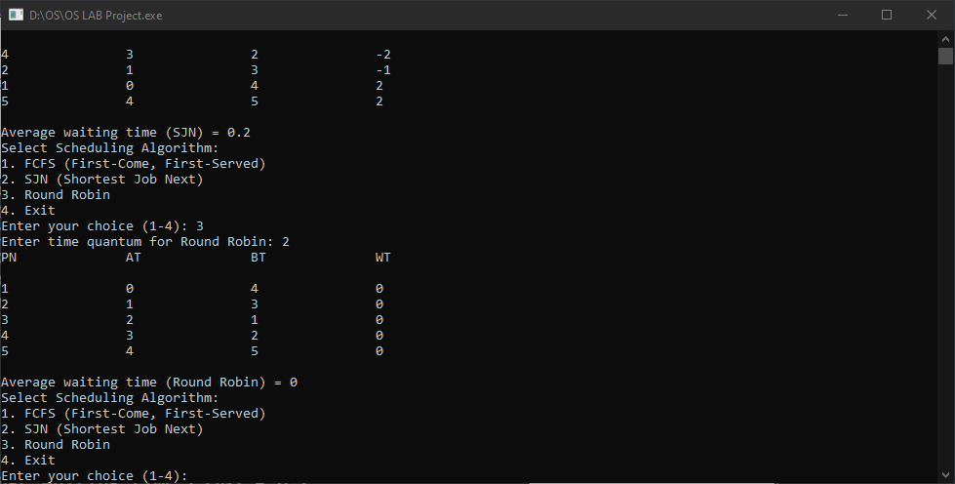
RR
OUPUT SAMPLE
AVERAGE TIME : 0

Slide 10
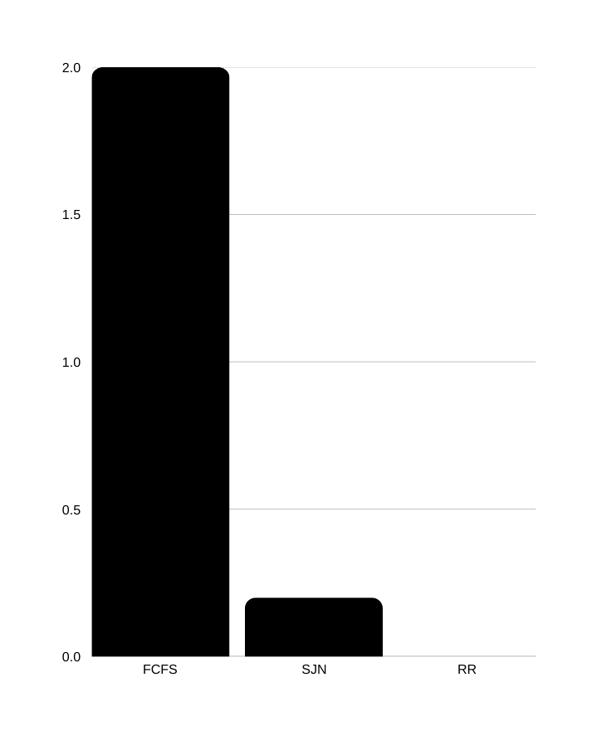

RESULTS AND ANALYSIS
The effect of Scheduler on Average Waiting Time for all processes can be clearly observed.
Average Waiting Time for FCFS: 2
Average Waiting Time for SJF: 0.2
Average Waiting Time for RR: 0

Slide 11

CONCLUSION
Key Learnings:
FCFS: Simple but inefficient.
SJN: Optimizes waiting time but requires burst time prediction.
Round Robin: Fair but dependent on time quantum.
Real-world Impact: Understanding scheduling algorithms helps in optimizing system performance.

Slide 12

THANK YOU!

